Slide 1
BMD ENG 301Quantitative Systems Physiology (Nervous System)
Cortex
2022_v1
Professor Malcolm A. MacIver

Slide 2
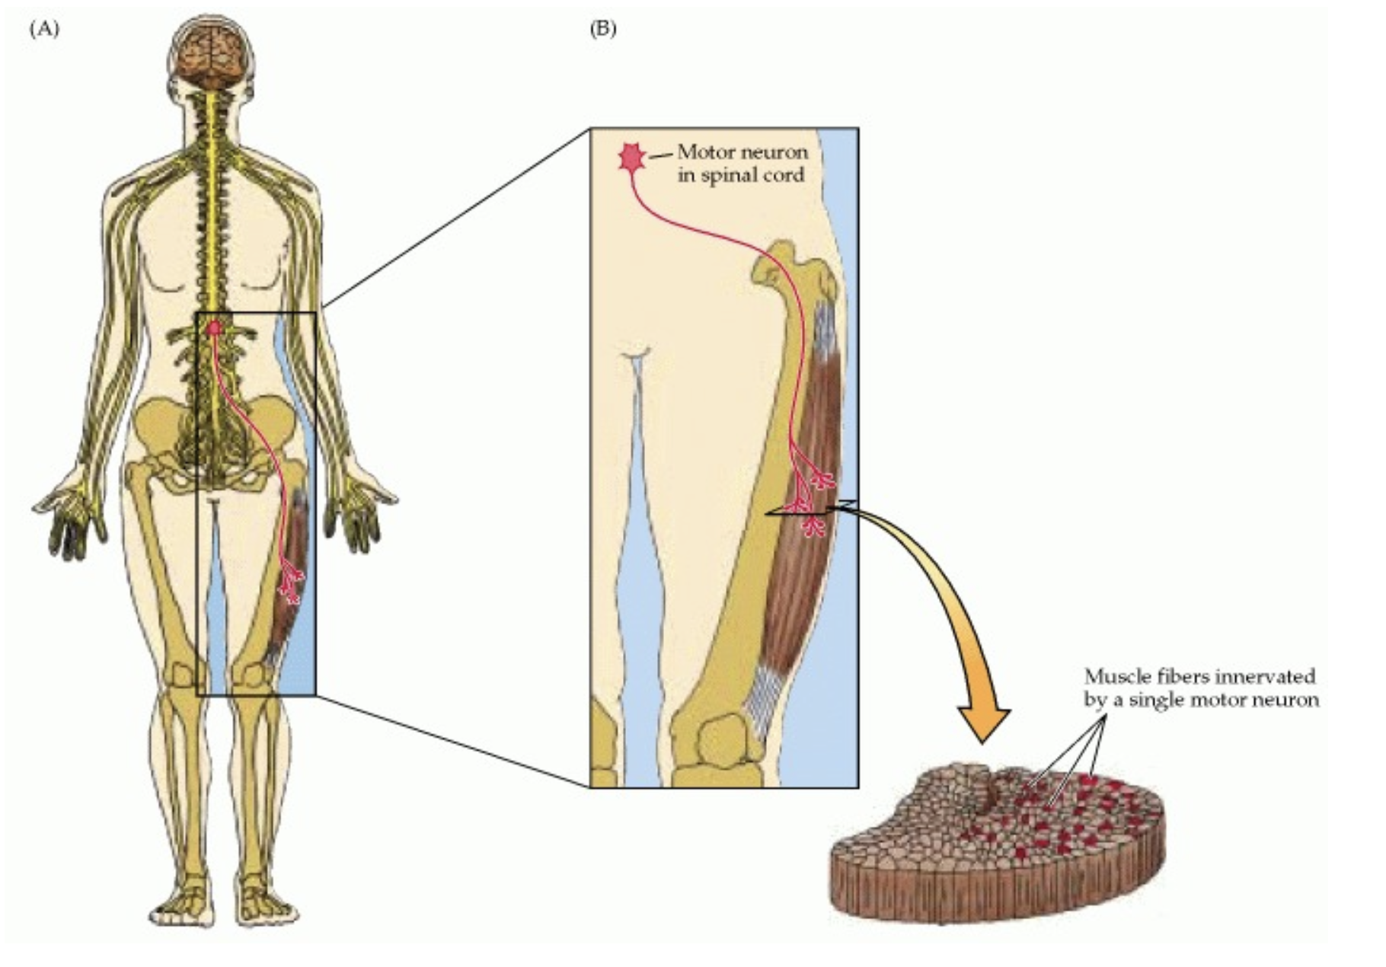
Motor unit, from Neuroscience 2nd edition

Slide 3
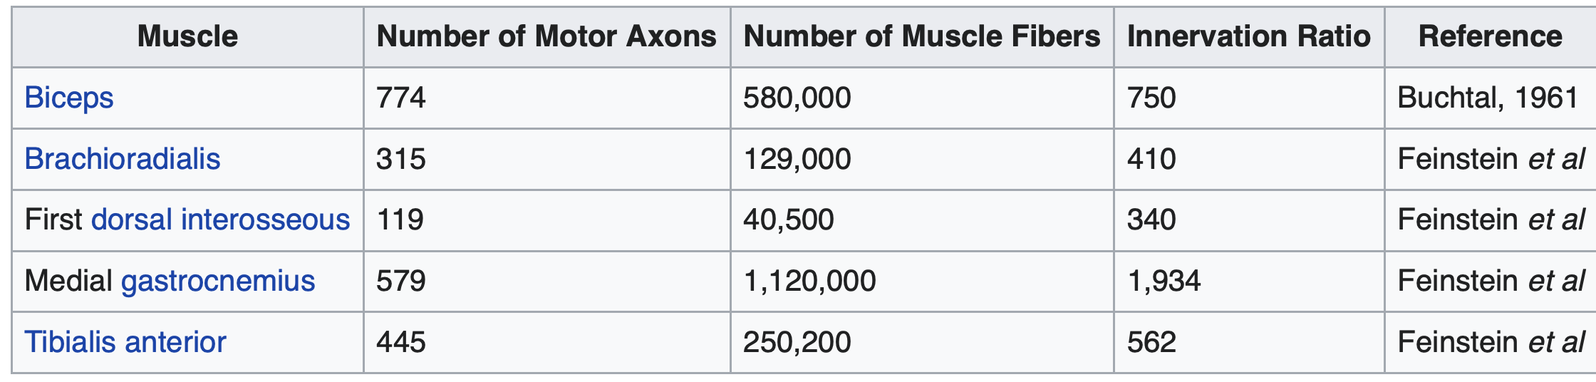
Important somatosensory and musculoskeletal system facts
Approximately 4 million touch receptors
Approx. 30,000—82,000 golgi tendon organs
Approx. 50,000 muscle spindles in the body
(320 pairs of muscles, for 640 muscles total)
(206 bones: 88 pairs – 176 – and 30 unpaired)
Approximately 200,000 motor units (one motor unit: a motor axon and all the muscle fibers it controls)
Wikipedia
‘Motor unit’
Accessed
Nov 2 2022

Slide 4
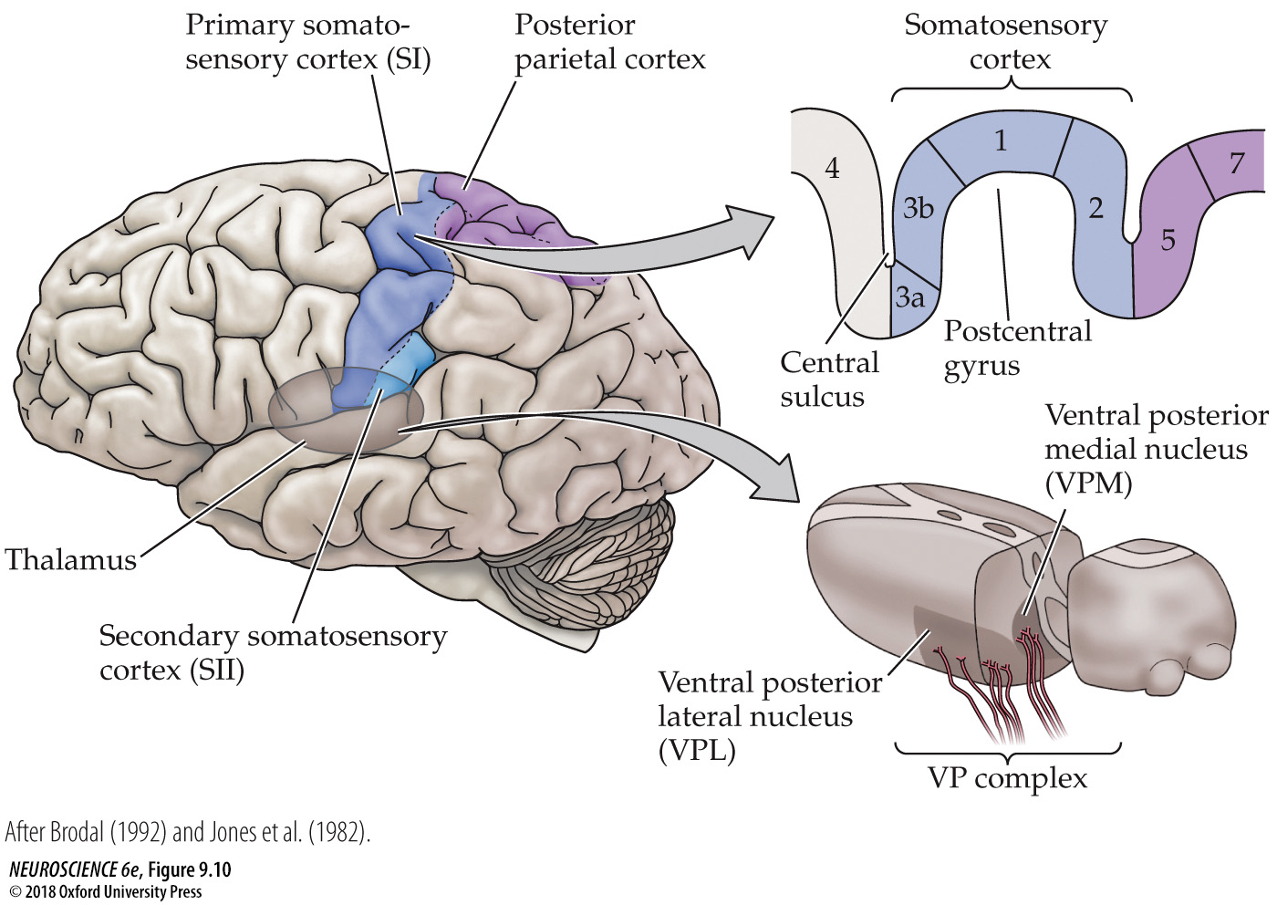
FIGURE 9.10 Somatosensory portions of the thalamus and their cortical targets in the postcentral gyrus
Notes:
FIGURE 9.10 Somatosensory portions of the thalamus and their cortical targets in the postcentral gyrus. The ventral posterior nuclear complex comprises the VPM, which relays somatosensory information carried by the trigeminal system from the face, and the VPL, which relays somatosensory information from the rest of the body. The diagram at the upper right shows the organization of the primary somatosensory cortex in the postcentral gyrus, shown here in a section cutting across the gyrus from anterior to posterior. (After Brodal, 1992 and Jones et al., 1982.)

Slide 5
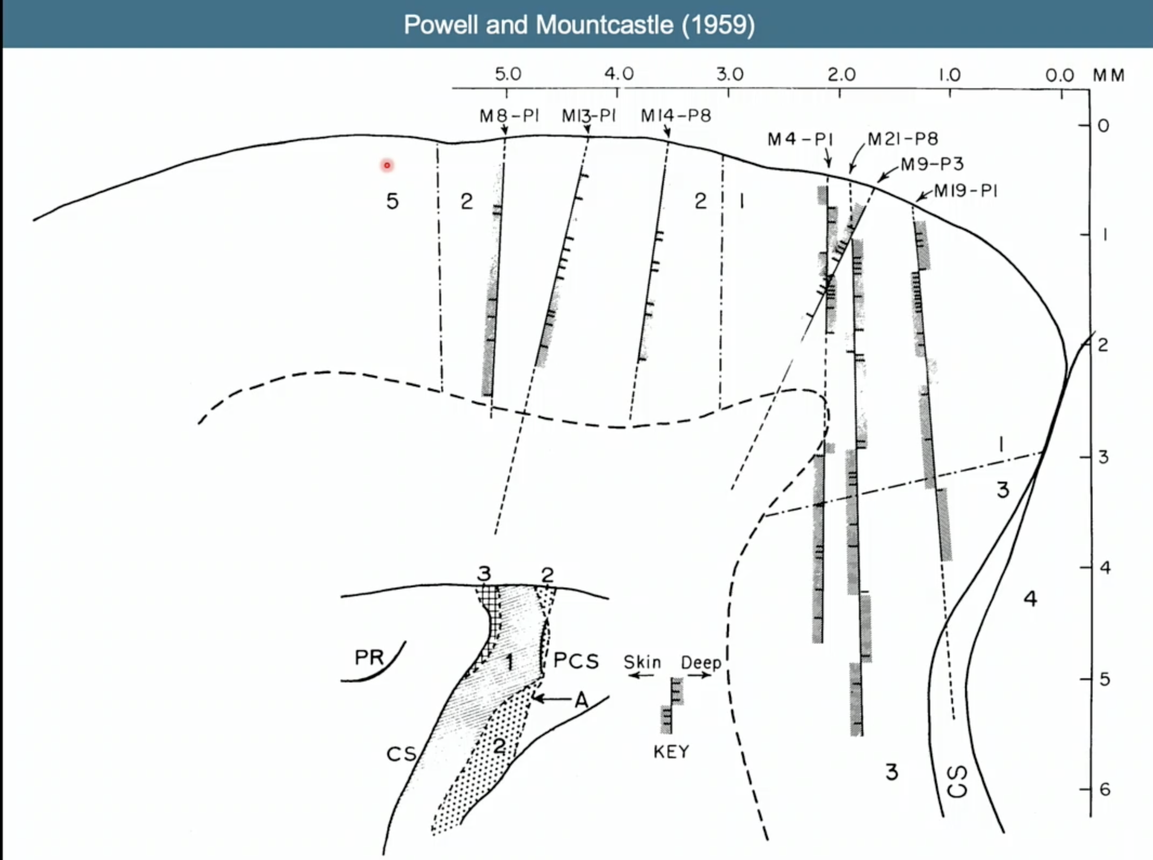

Slide 6
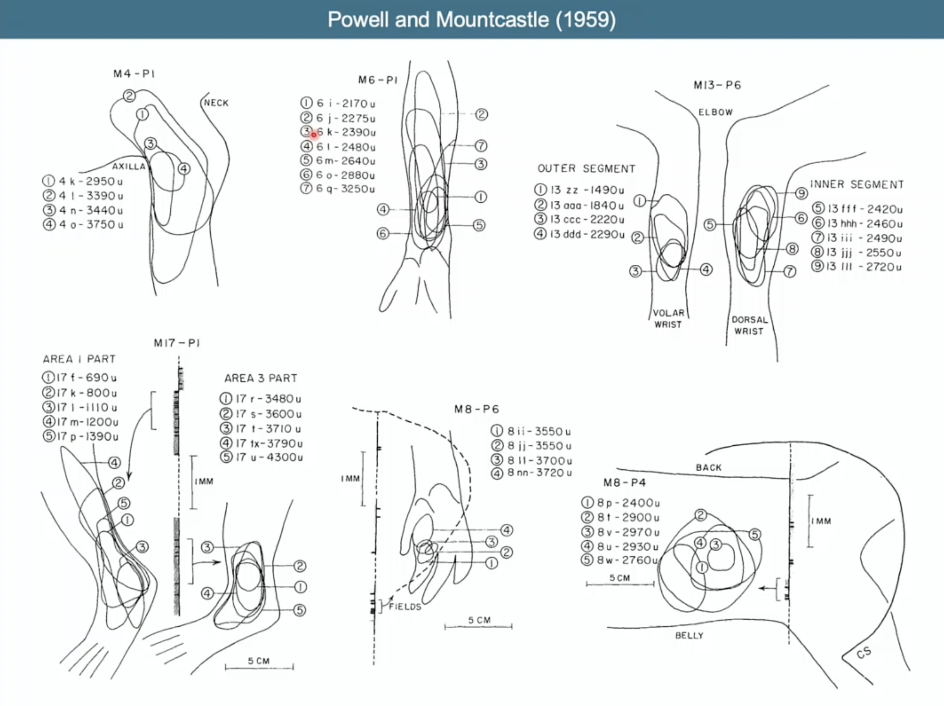

Slide 7
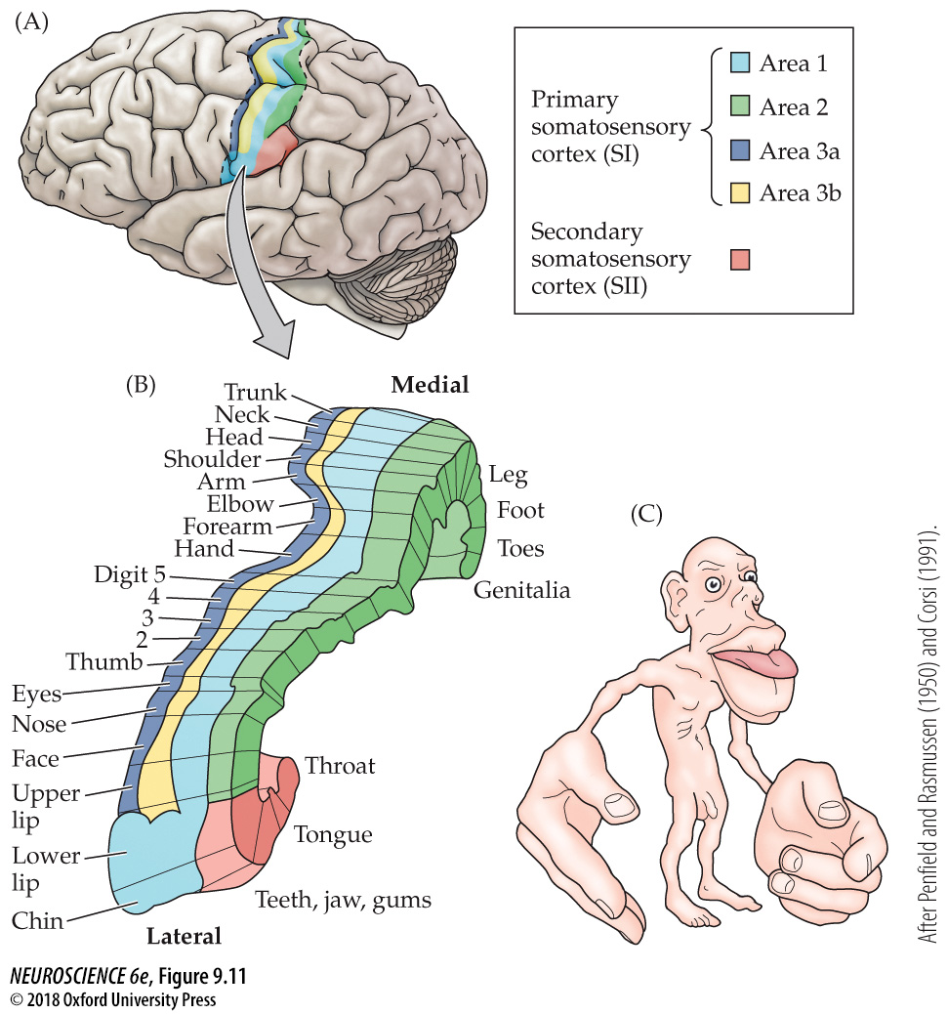

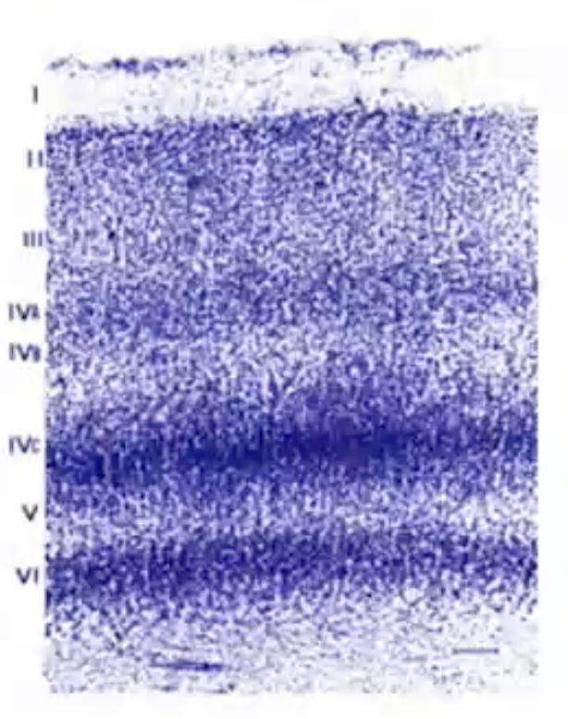
FIGURE 9.11 Somatotopic order in the human primary somatosensory cortex
Notes:
FIGURE 9.11 Somatotopic order in the human primary somatosensory cortex. (A) Diagram showing the region of the human cortex from which electrical activity is recorded following mechanosensory stimulation of different parts of the body. (The patients in the study were undergoing neurosurgical procedures for which such mapping was required.) Although modern imaging methods are now refining these classical data, the human somatotopic map defined in the 1930s has remained generally valid. (B) Diagram showing the somatotopic representation of body parts from medial to lateral. (C) Cartoon of the homunculus constructed on the basis of such mapping. Note that the amount of somatosensory cortex devoted to the hands and face is much larger than the relative amount of body surface in these regions. A similar disproportion is apparent in the primary motor cortex, for much the same reasons (see Chapter 17). (After Penfield and Rasmussen, 1950, and Corsi, 1991.)

Slide 8
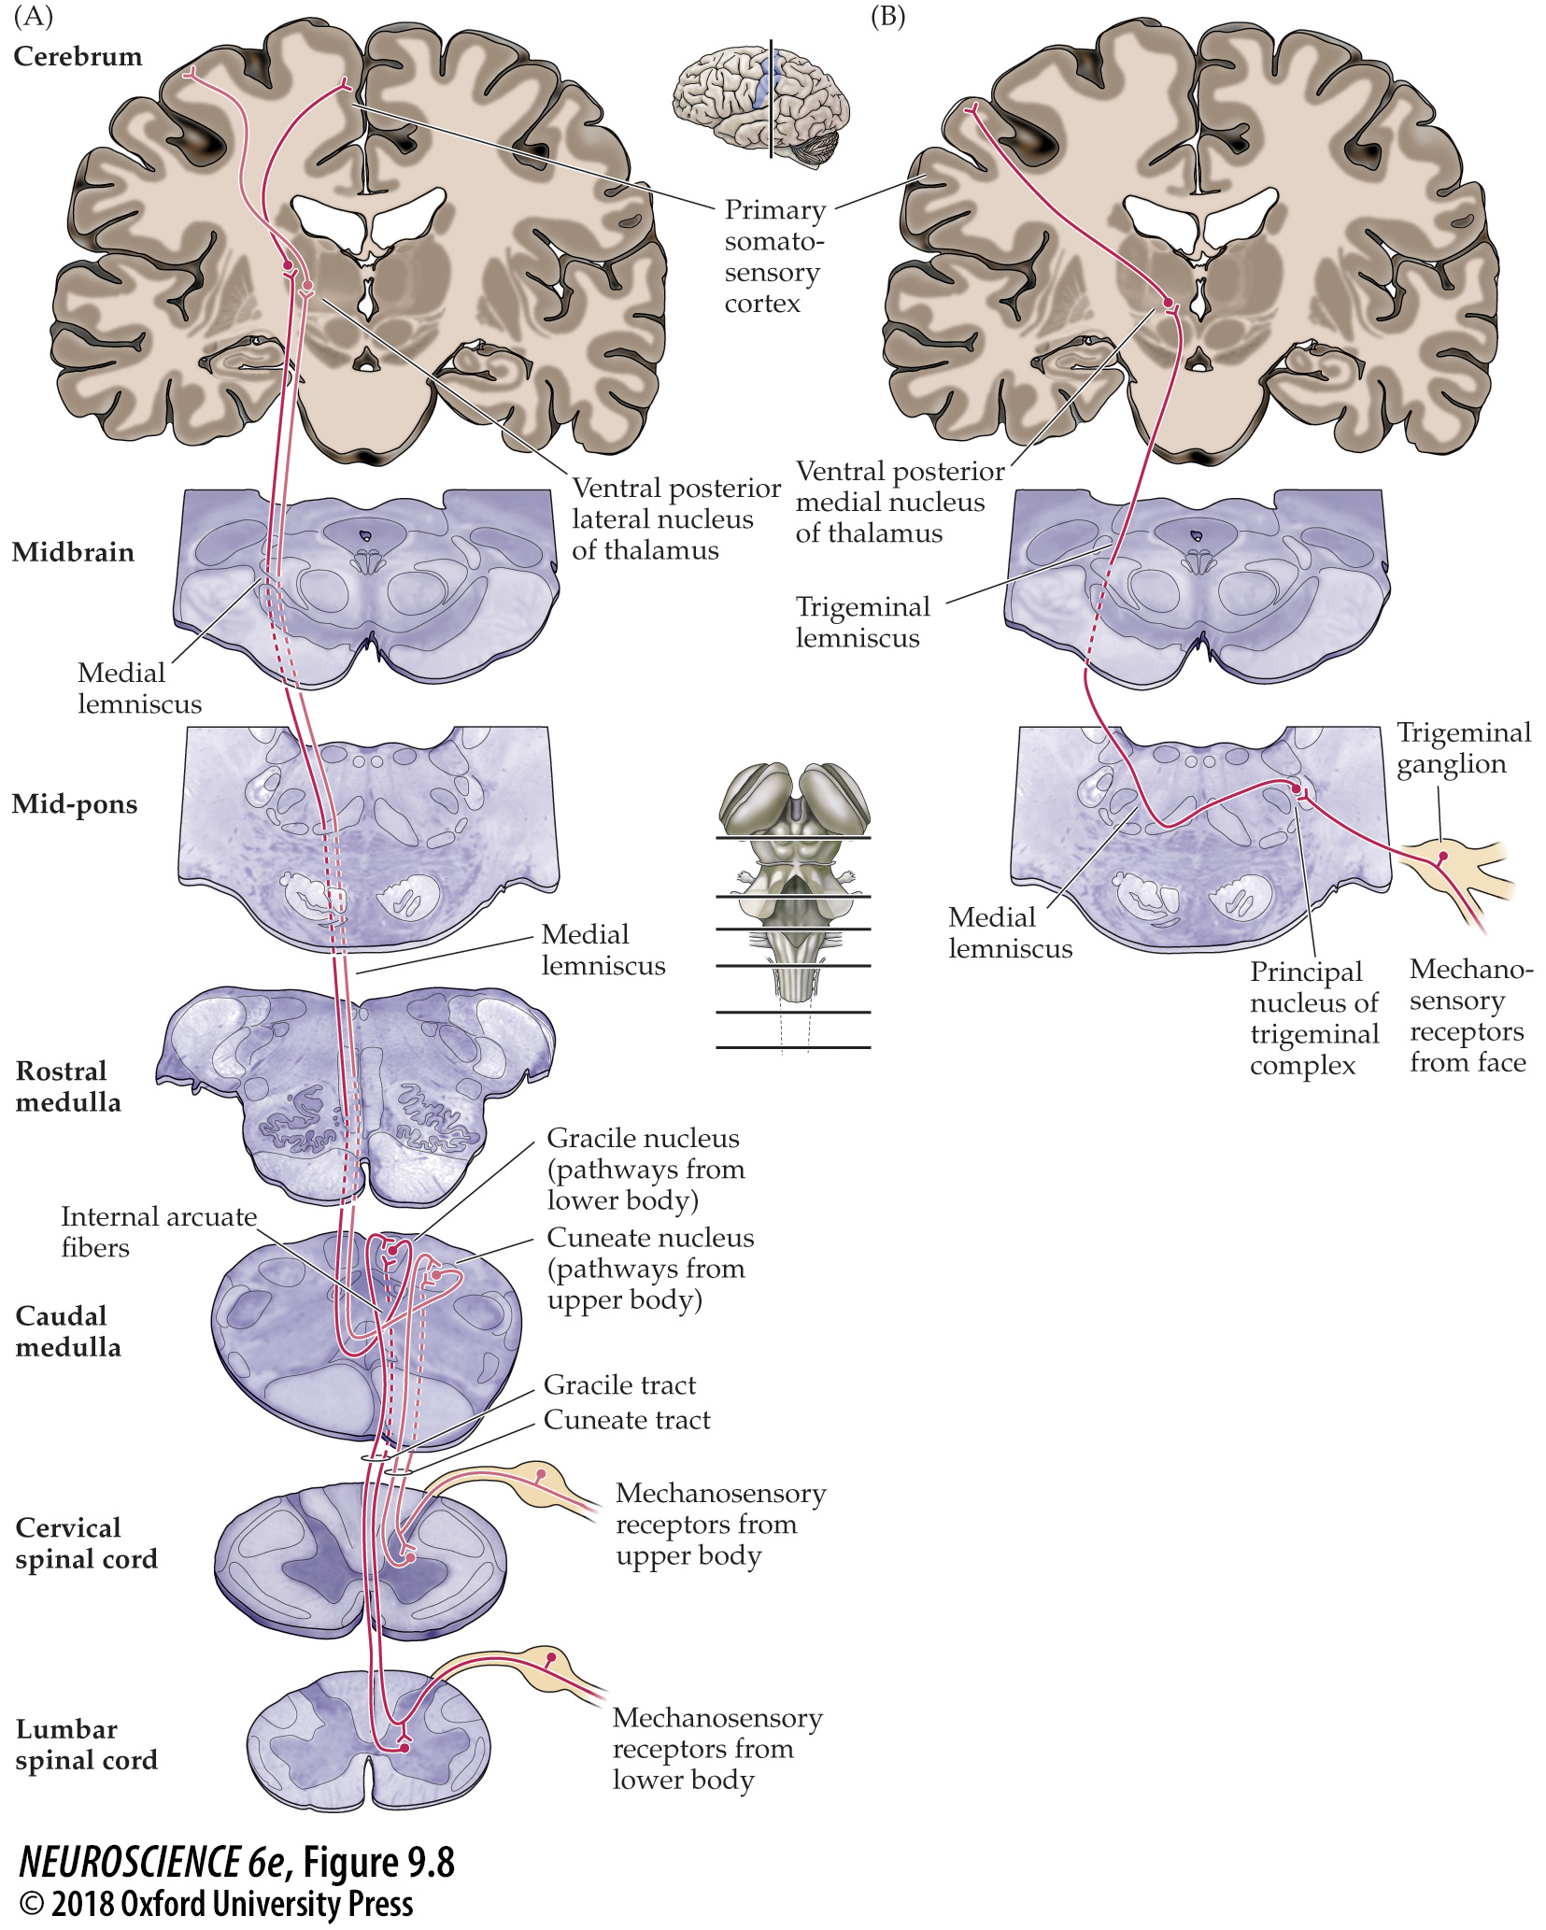
FIGURE 9.8 The main touch pathways
Notes:
FIGURE 9.8 The main touch pathways. (A) The dorsal column–medial lemniscal pathway carries mechanosensory information from the posterior third of the head and the rest of the body. (B) The trigeminal portion of the mechanosensory system carries similar information from the face.

Slide 9
FIGURE 9.11 Somatotopic order in the human primary somatosensory cortex
Notes:
FIGURE 9.11 Somatotopic order in the human primary somatosensory cortex. (A) Diagram showing the region of the human cortex from which electrical activity is recorded following mechanosensory stimulation of different parts of the body. (The patients in the study were undergoing neurosurgical procedures for which such mapping was required.) Although modern imaging methods are now refining these classical data, the human somatotopic map defined in the 1930s has remained generally valid. (B) Diagram showing the somatotopic representation of body parts from medial to lateral. (C) Cartoon of the homunculus constructed on the basis of such mapping. Note that the amount of somatosensory cortex devoted to the hands and face is much larger than the relative amount of body surface in these regions. A similar disproportion is apparent in the primary motor cortex, for much the same reasons (see Chapter 17). (After Penfield and Rasmussen, 1950, and Corsi, 1991.)

Slide 10
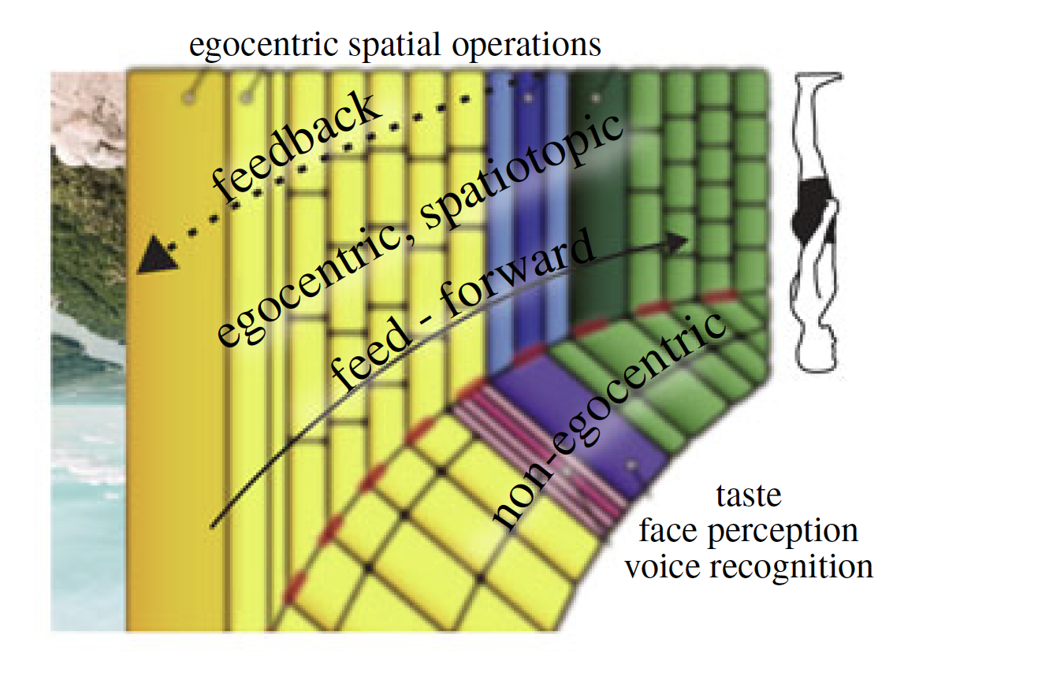
FIGURE 9.11 Somatotopic order in the human primary somatosensory cortex
Notes:
FIGURE 9.11 Somatotopic order in the human primary somatosensory cortex. (A) Diagram showing the region of the human cortex from which electrical activity is recorded following mechanosensory stimulation of different parts of the body. (The patients in the study were undergoing neurosurgical procedures for which such mapping was required.) Although modern imaging methods are now refining these classical data, the human somatotopic map defined in the 1930s has remained generally valid. (B) Diagram showing the somatotopic representation of body parts from medial to lateral. (C) Cartoon of the homunculus constructed on the basis of such mapping. Note that the amount of somatosensory cortex devoted to the hands and face is much larger than the relative amount of body surface in these regions. A similar disproportion is apparent in the primary motor cortex, for much the same reasons (see Chapter 17). (After Penfield and Rasmussen, 1950, and Corsi, 1991.)

Slide 11
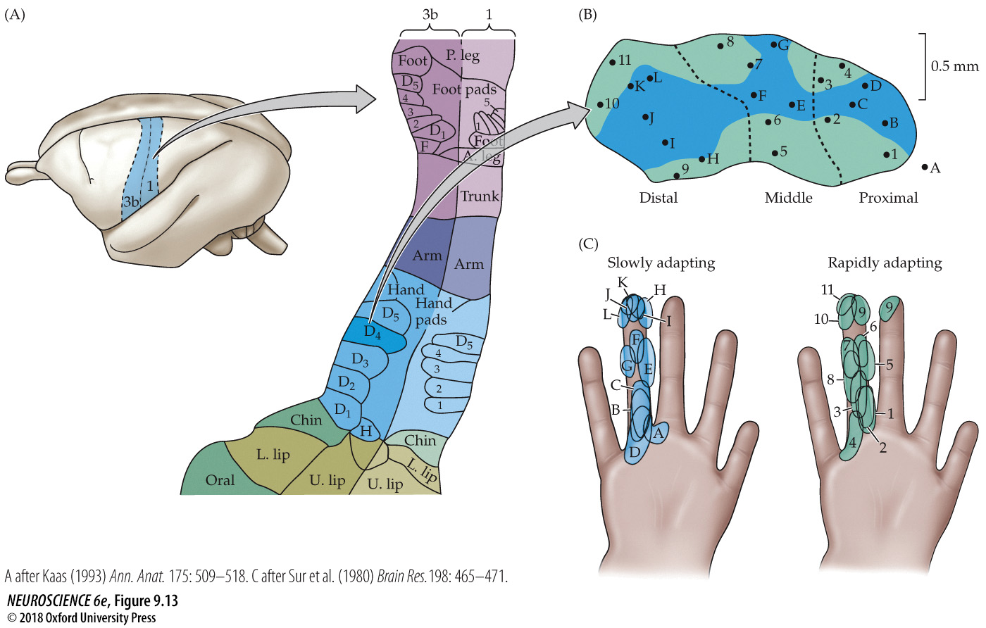
FIGURE 9.13 Neurons in the primary somatosensory cortex form functionally distinct columns
Notes:
FIGURE 9.13 Neurons in the primary somatosensory cortex form functionally distinct columns. (A) Primary somatosensory map in the owl monkey based, as for the human in Figure 9.11, on the electrical responsiveness of the cortex to peripheral stimulation. The enlargement on the right shows Brodmann’s areas 3b and 1, which process most cutaneous mechanosensory information. The arrangement is generally similar to that determined in humans. Note the presence of regions that are devoted to the representation of individual digits. (B) Modular organization of responses within the representation of a single digit, showing the location of electrode penetrations that encountered rapidly adapting (green) and slowly adapting (blue) responses within the representation of digit 4. (C) Distribution of slowly adapting and rapidly adapting receptive fields used to derive the plot in (B). Although the receptive fields of these different classes of afferents overlap on the skin surface, they are partially segregated within the cortical representation (A after Kaas, 1993; C after Sur et al., 1980.)

Slide 12
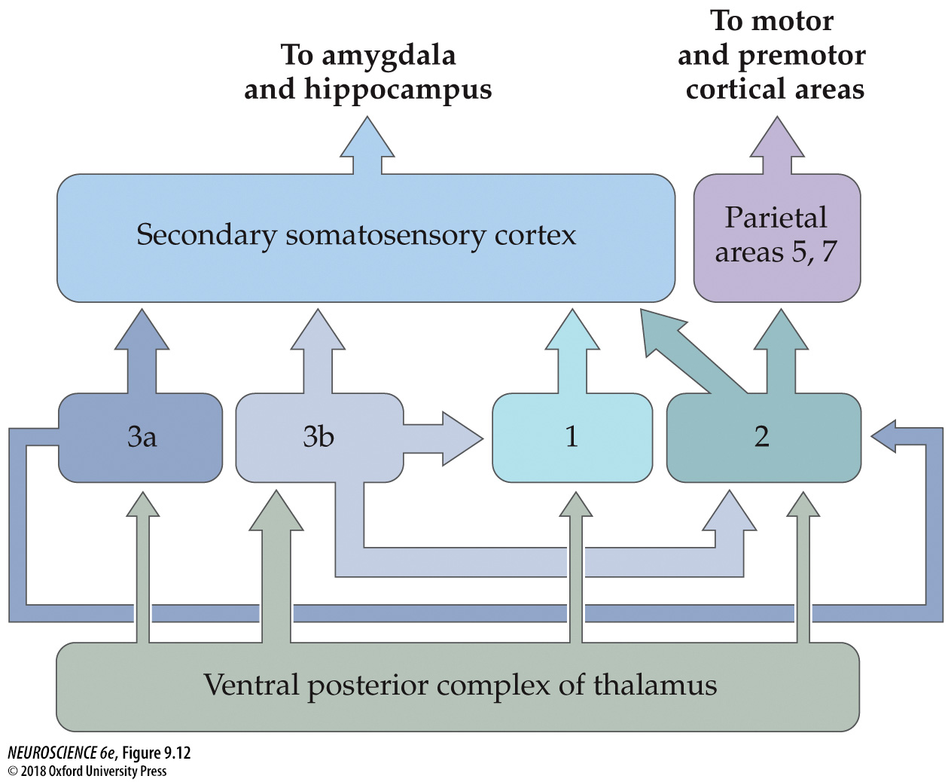
FIGURE 9.12 Connections within the somatosensory cortex establish functional hierarchies
Notes:
FIGURE 9.12 Connections within the somatosensory cortex establish functional hierarchies. Inputs from the ventral posterior complex of the thalamus terminate in Brodmann’s areas 3a, 3b, 1, and 2, with the greatest density of projections in area 3b. Area 3b in turn projects heavily to areas 1 and 2, and the functions of these areas are dependent on the activity of area 3b. All subdivisions of primary somatosensory cortex project to secondary somatosensory cortex; the functions of SII are dependent on the activity of SI.

Slide 13
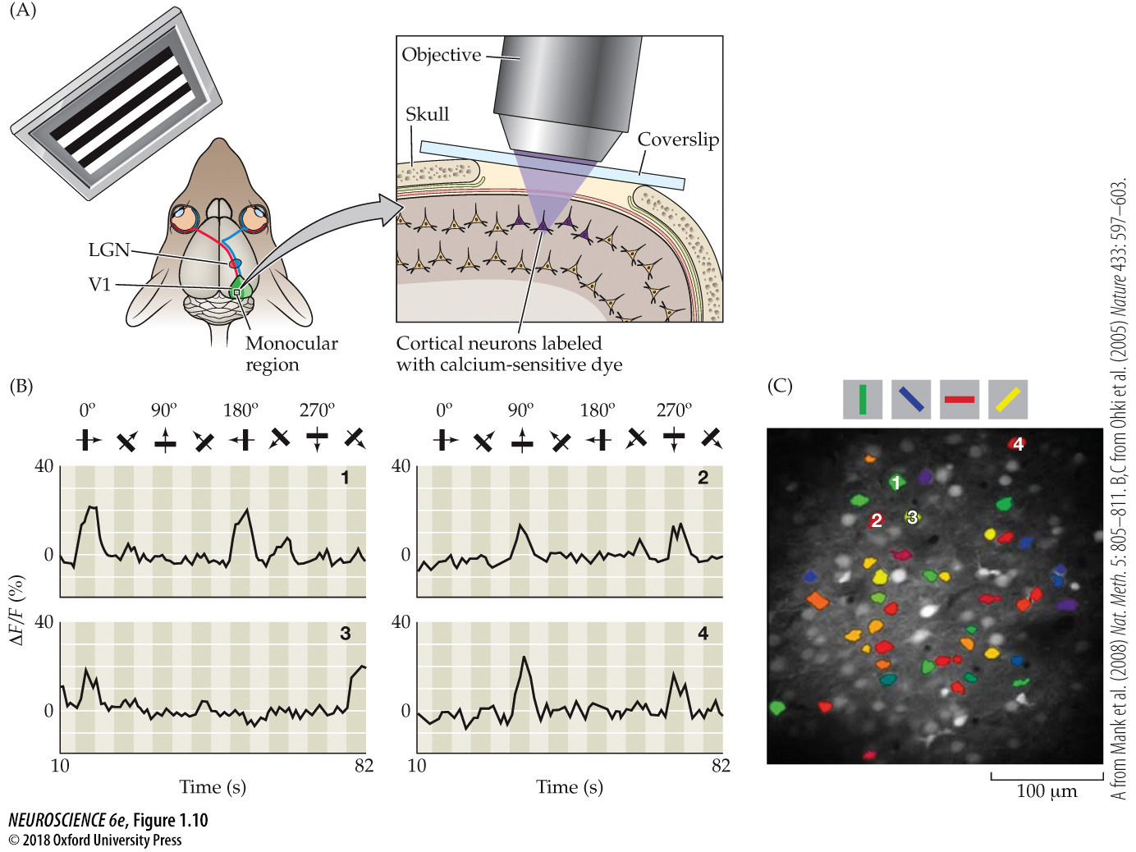
Imaging cortical neurons responding to visual stimuli using calcium-sensitive dyes
Notes:
Figure 1.10 Imaging cortical neurons responding to visual stimuli using calcium-sensitive dyes. (A) The imaging was done in a live mouse presented with visual stimuli at different orientations (a horizontally oriented series of high-contrast stripes is shown here). A small “window” of bone was removed over the visual cortex for application of the dyes and subsequent imaging; changes in fluorescence intensity were detected using a microscope with the objective over the exposed cortical surface. (LGN = lateral geniculate nucleus; V1 = primary visual cortex.) (B) The change in fluorescence intensity (∆ F/F [%]) of four cells imaged this way while the mouse viewed stripes in the orientations shown at the top of the graphs, moving in directions indicated by the arrows (numbers 1–4 on the graphs identify the cells, which can be localized in C). Each separate graph shows the response over time of one cortical cell. In each graph, the peaks in fluorescence signal indicate robust responses when the cell’s preferred stimulus orientation was presented; little response was elicited by nonpreferred stimuli. (C) The distribution of cells with preferred responses to stripes oriented at different angles (colors indicate preferred orientation). Activated cells preferring different orientations were interspersed, with each orientation represented by several cells in different positions within this small cortical area. (A from Mank, et al., 2008; B,C from Ohki et al., 2005.)

Slide 14
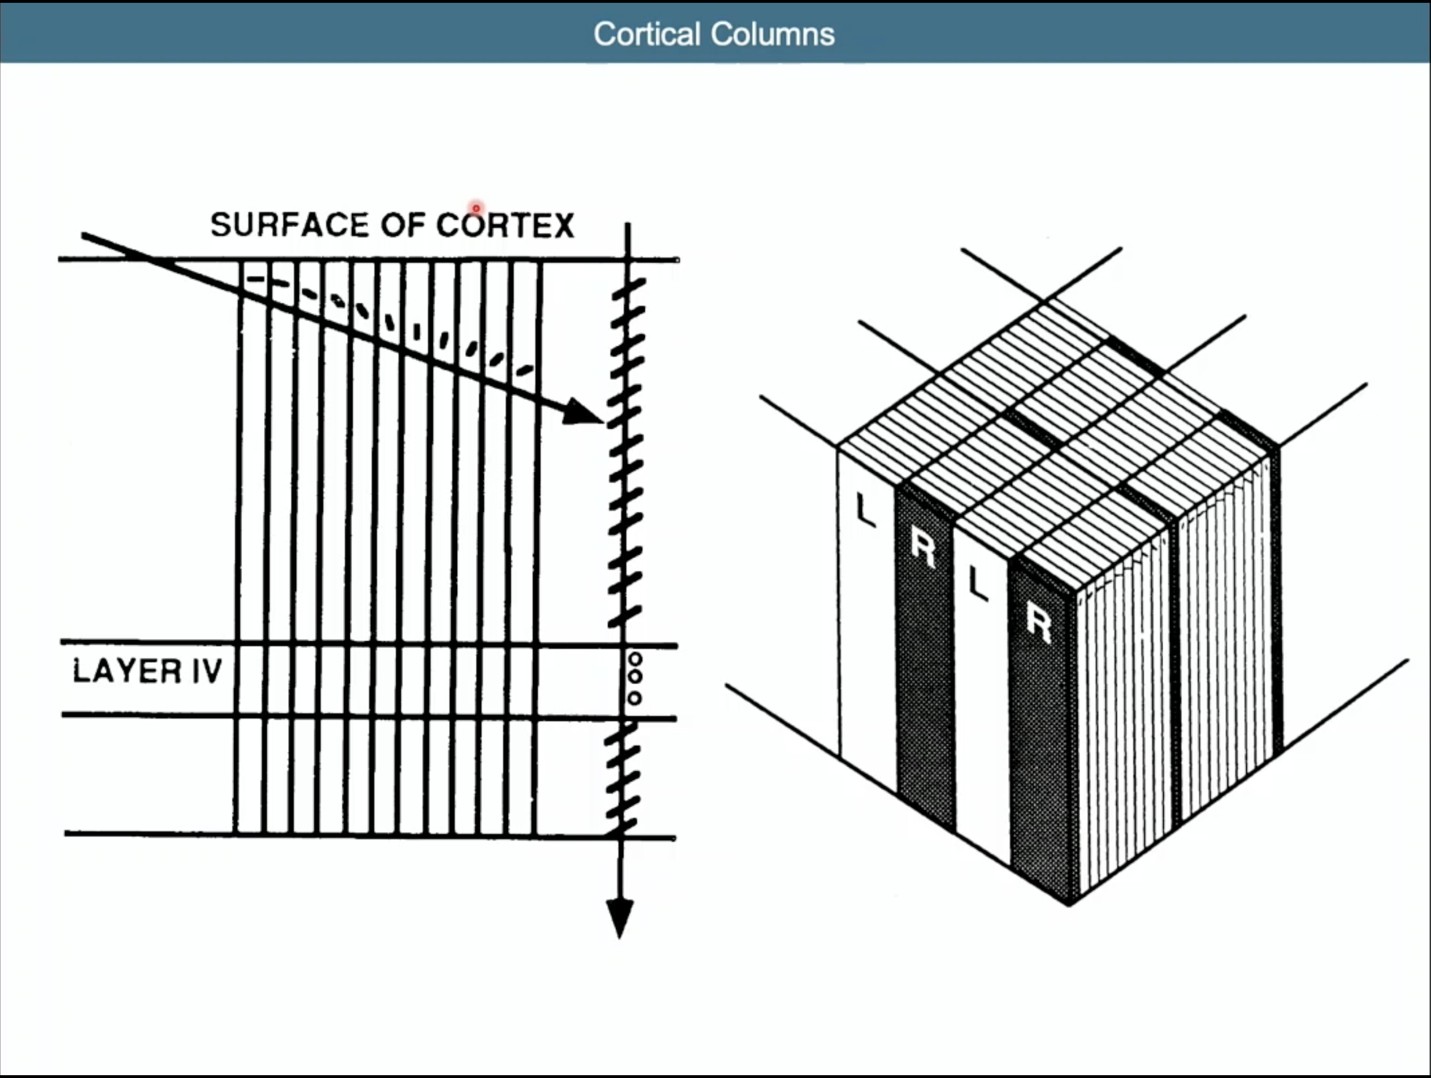

Slide 15
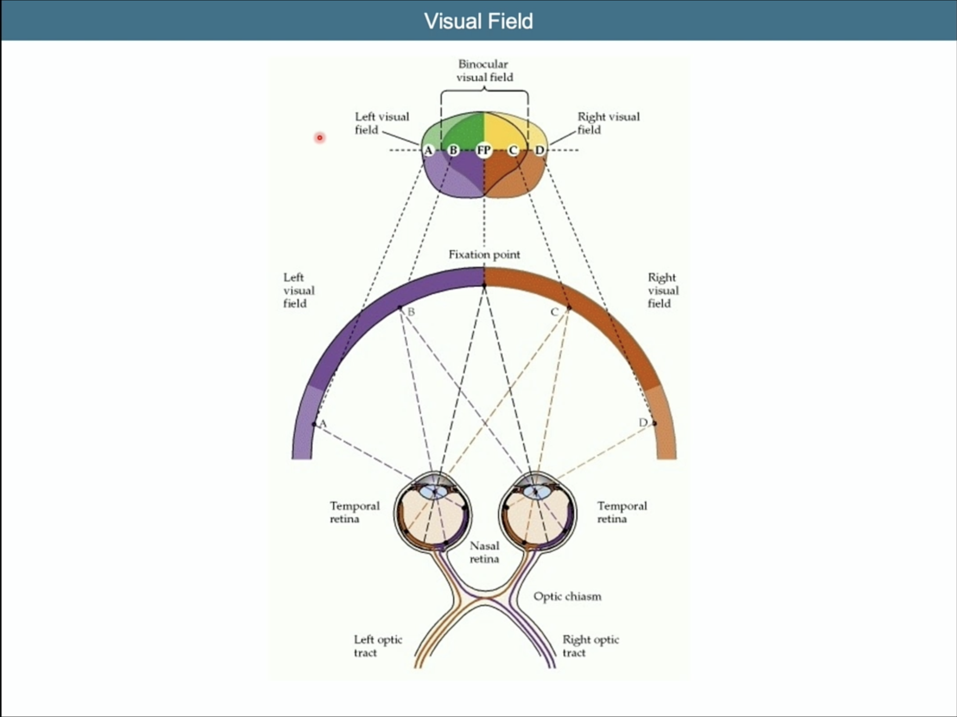

Slide 16
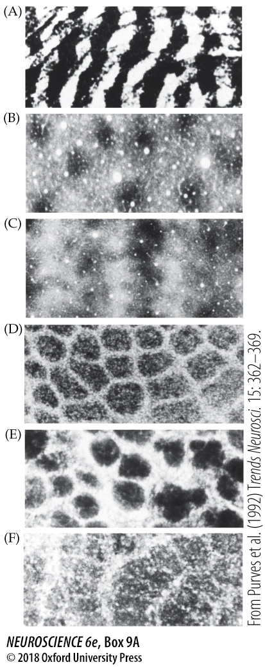
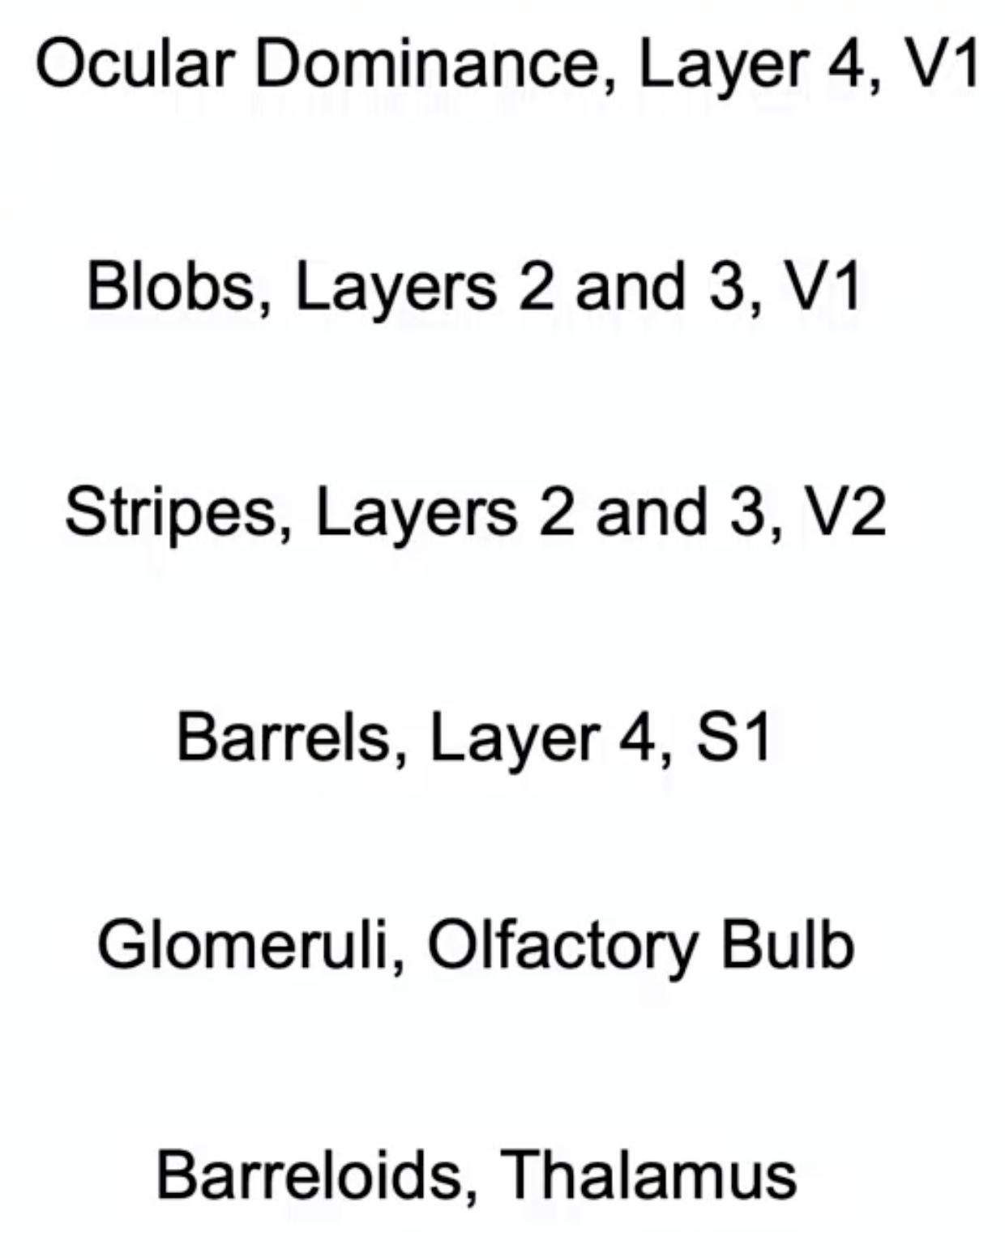
Box 9A Patterns of Organization within the Sensory Cortices: Brain Modules
Notes:
Box 9A Patterns of Organization within the Sensory Cortices: Brain Modules
Examples of iterated modular substructures in the mammalian brain. (A) Ocular dominance columns in layer IV in the primary visual cortex (V1) of a rhesus monkey. (B) Repeating units called blobs in layers II and III in V1 of a squirrel monkey. (C) Stripes in layers II and III in V2 of a squirrel monkey. (D) Barrels in layer IV in primary somatosensory cortex of a rat. (E) Glomeruli in the olfactory bulb of a mouse. (F) Iterated units called barreloids in the thalamus of a rat. These and other examples indicate that modular organization is commonplace in the brain. These units are on the order of 100 to several hundred microns across. (From Purves et al., 1992.)

Slide 19
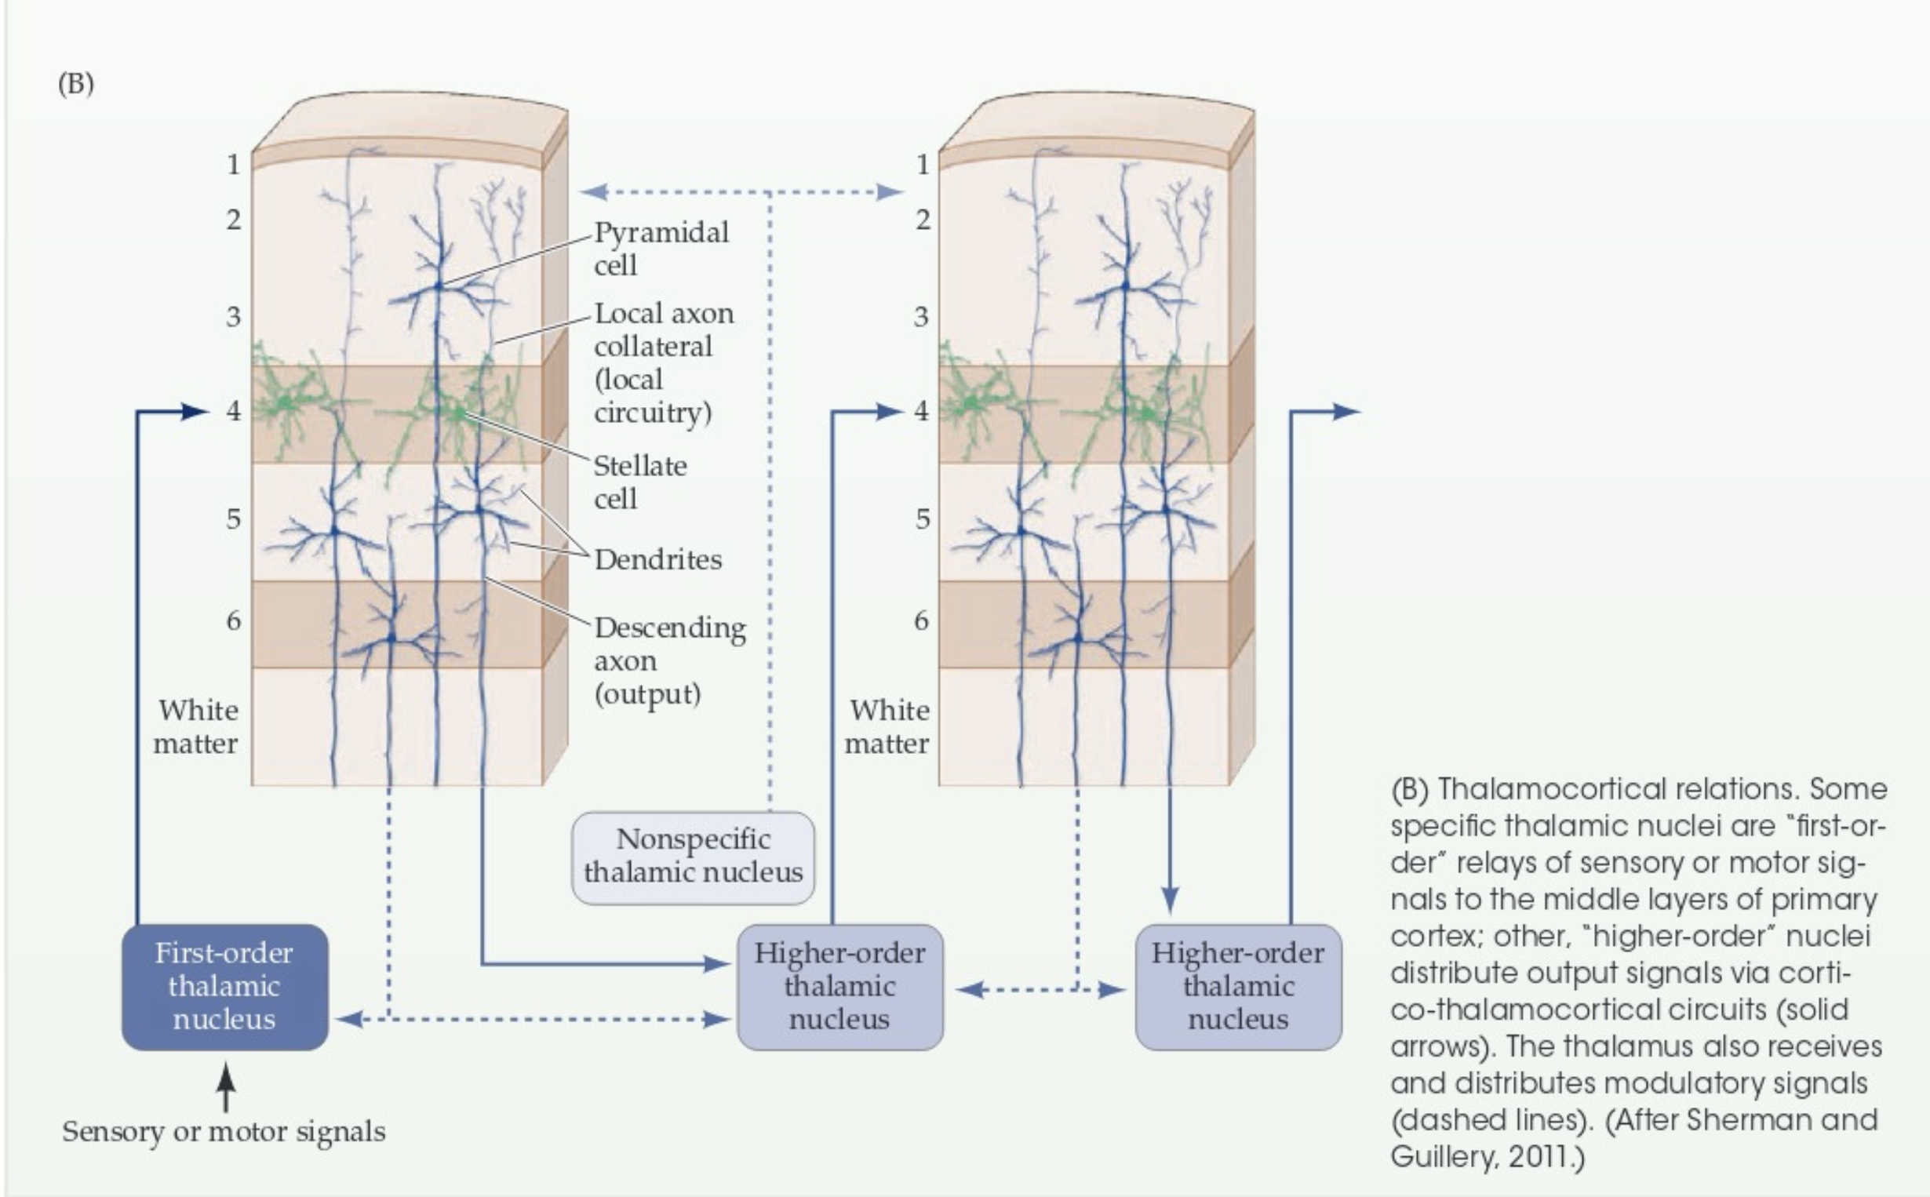

Slide 20
